Slide 1
European Open Science Cloud
Russel Wolff
r.g.wolff@usit.uio.no

Slide 2
Agenda
What is EOSC?
Our involvement
Projects
Events
Upcoming calls

Slide 3
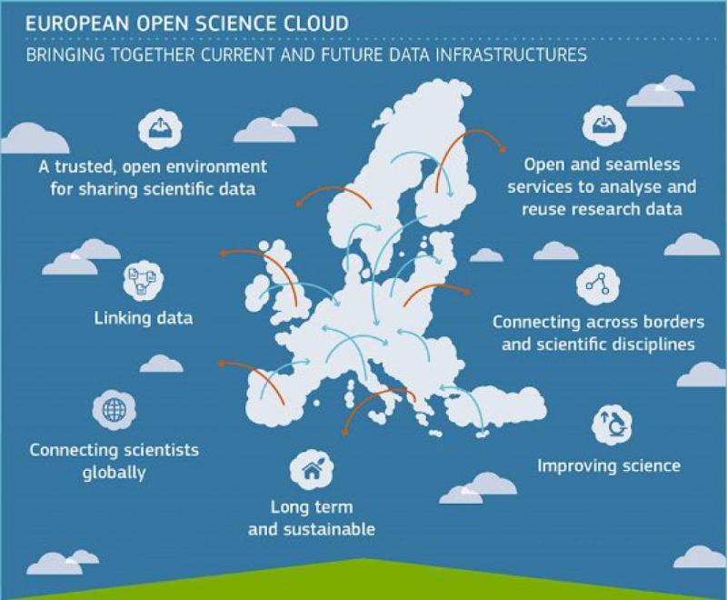
What is EOSC?
”The ambition of the European Open Science Cloud (EOSC) is to provide European researchers, innovators, companies and citizens with a federated and open multi-disciplinary environment where they can publish, find and reuse data, tools and services for research, innovation and educational purposes.”
Overall aim is to develop a “web of FAIR data and services”
Consists of over 250 member and observer organizations.
https://digital-strategy.ec.europa.eu/en/policies/open-science-cloud

Slide 4
Involvement in EOSC Association
Applied for, and granted, member status in 2022. (Membership currently sponsored by RCN)
Fits strategy of sharing research infrastructure and data resources.
Currently contributing TSD in the EOSC Marketplace
Participate in events/advisory groups/task forces to help shape the future of EOSC
  Also national level meetings led by RCN
Contribution towards Additional Activities Plan 2024

Slide 5
Participation in funded projects
EOSC – Life
  create an open collaborative space for digital biology in response to the challenge of analysing and reusing data produced by life-science
EOSC – ENTRUST
  create a European network of trusted research environments for sensitive data and to drive European interoperability by joint development of a common blueprint for federated data access and analysis
BY – Covid
  provides comprehensive open data across scientific, medical, public health and policy domains. It enables federated data analysis as well as long-term cataloguing to ensure interoperability of national and global efforts, exploiting and contributing to the EOSC for data access and federation
AI – Mind
  screens for mild cognitive impairment (MCI) as a way of predicting dementia – develop and coordinate data platform

Slide 6

Events
EOSC Association is very active, with a number of events
GA – focus on pathway to the future of EOSC
Symposium – various tracks and breakout sessions

Slide 7
Upcoming Calls
HORIZON EUROPE, INFRAEOSC 2024, Draft Calls
HORIZON-INFRA-2024-EOSC-01-01: FAIR and open data sharing in support of the mission adaptation to climate change
HORIZON-INFRA-2024-EOSC-01-02: Supporting the EOSC Partnership in further consolidating the coordination and sustainability of the EOSC ecosystem
HORIZON-INFRA-2024-EOSC-01-03: Enabling a network of EOSC federated and trustworthy repositories and enhancing the framework of generic and discipline specific services for data and other research digital objects
HORIZON-INFRA-2024-EOSC-01-04: Long-term access and preservation infrastructure development for EOSC, including data quality aspects
HORIZON-INFRA-2024-EOSC-01-05: Innovative and customizable services for EOSC Exchange

