Slide 1
European Open Science Cloud Update
Russel Wolff
r.g.wolff@usit.uio.no

Slide 2
Agenda
Projects
Activities & events
Nodes and the EOSC Federation
EOSC Post-2027

Slide 3


Participation in projects
Ongoing Project:
  EOSC – ENTRUST: create a European network of trusted research environments for sensitive data and to drive European interoperability by joint development of a common blueprint for federated data access and analysis
Recent EU applications
  TRELISS
  MatFound

Slide 4
Ongoing Activities
Task Force Participation

Slide 5
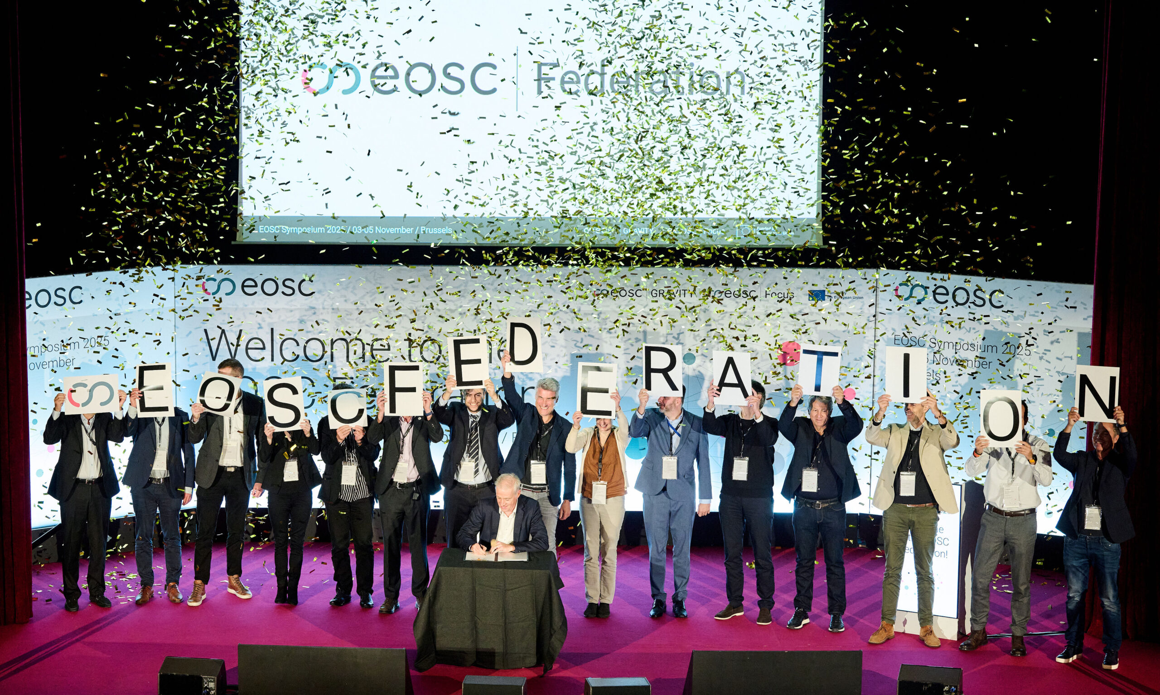
Nodes and the EOSC Federation
Symposium 3-5 Nov – various tracks and breakout sessions, particular focus on pilot Nodes and the launch of the EOSC Federation
  Norwegian Node?

Slide 6

EOSC Post-2027
GA 10 Dec – focus on pathway to the future of EOSC Post-2027 and election of directors
EOSC Association is currently funded through 2027
  There will be a new Multi-annual Financial Framework (MFF) 2028-2034 as part of FP10
  Not certain, but a significant portion must come from Member States (no longer just in-kind)
  Discussions ongoing with Mandated Organizations (Research Council of Norway)

